Slide 1
Geometry and Latent Signal Representations in Machine Learning
Daniel D. Lee
Notes:
안녕하세요? 저는 미국에서 태어났어요. 그래서 한국말 잘 못해요.
미안하지만 오늘 영어로 해야 합니다.

Slide 2
Outline
How to understand empirical successes of large and deep neural networks?
Neural representations and manifolds
Statistical theory of manifold geometry for latent signals
Manifolds and generative models

Slide 3
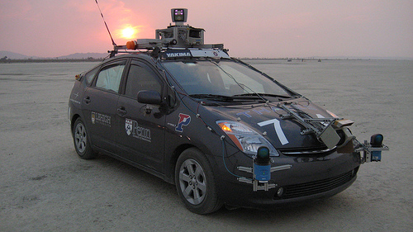

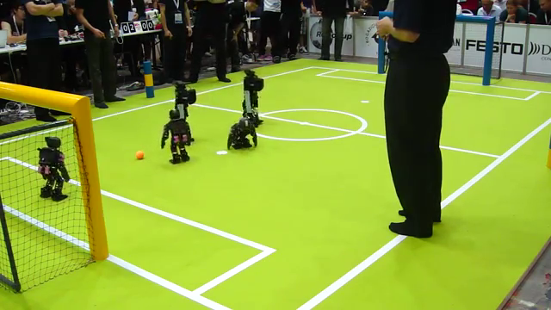
Engineering applications
DARPA Challenges
Samsung AI Centers
RoboCup
Development of autonomous robots and AI devices

Slide 4
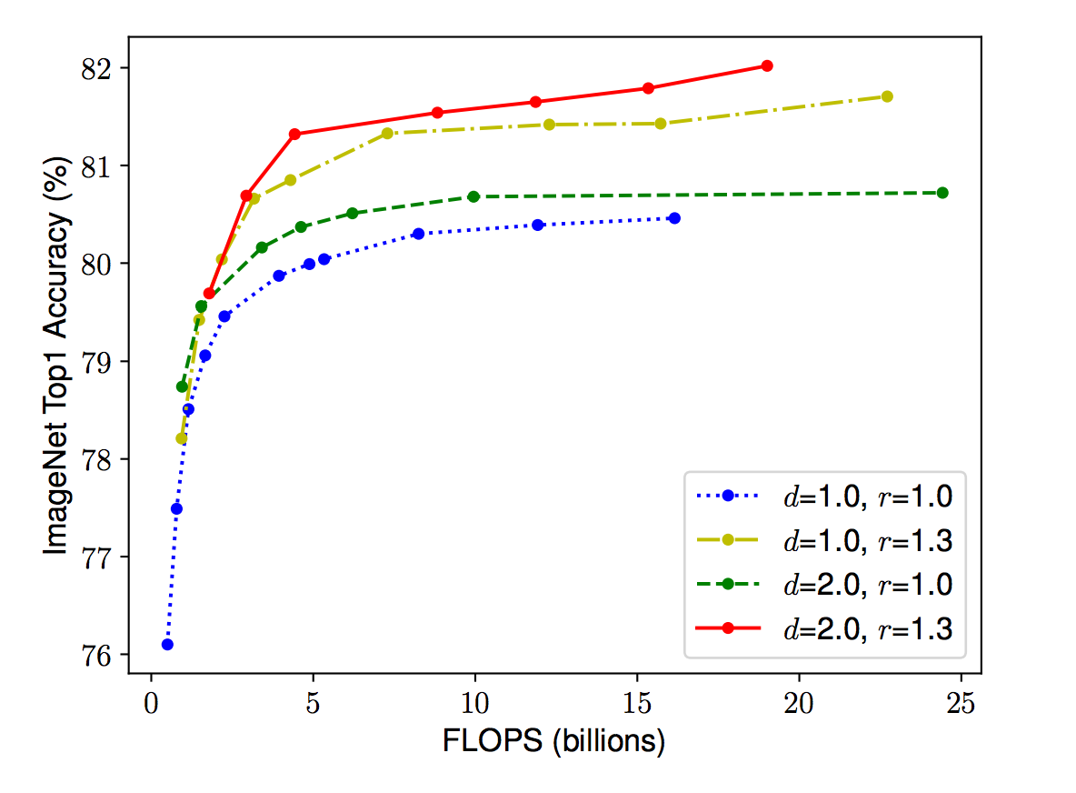
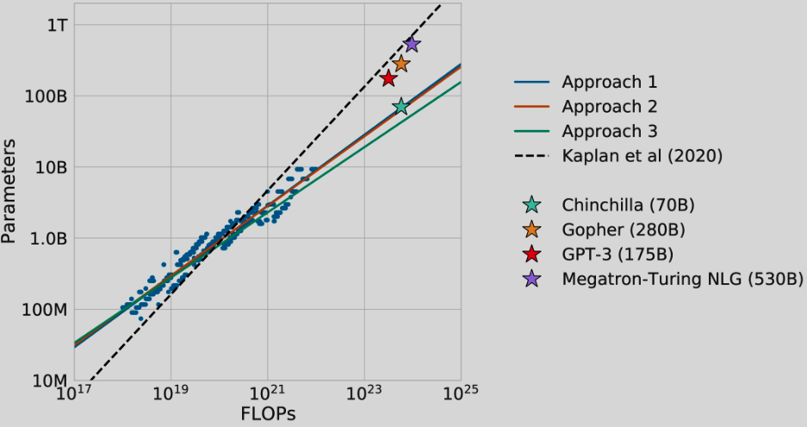
Power of scaling
Hoffmann, et. al. (2022)
Tan and Le (2019)
Moore’s law and Internet-scale data fueling large model performance improvements

Slide 5
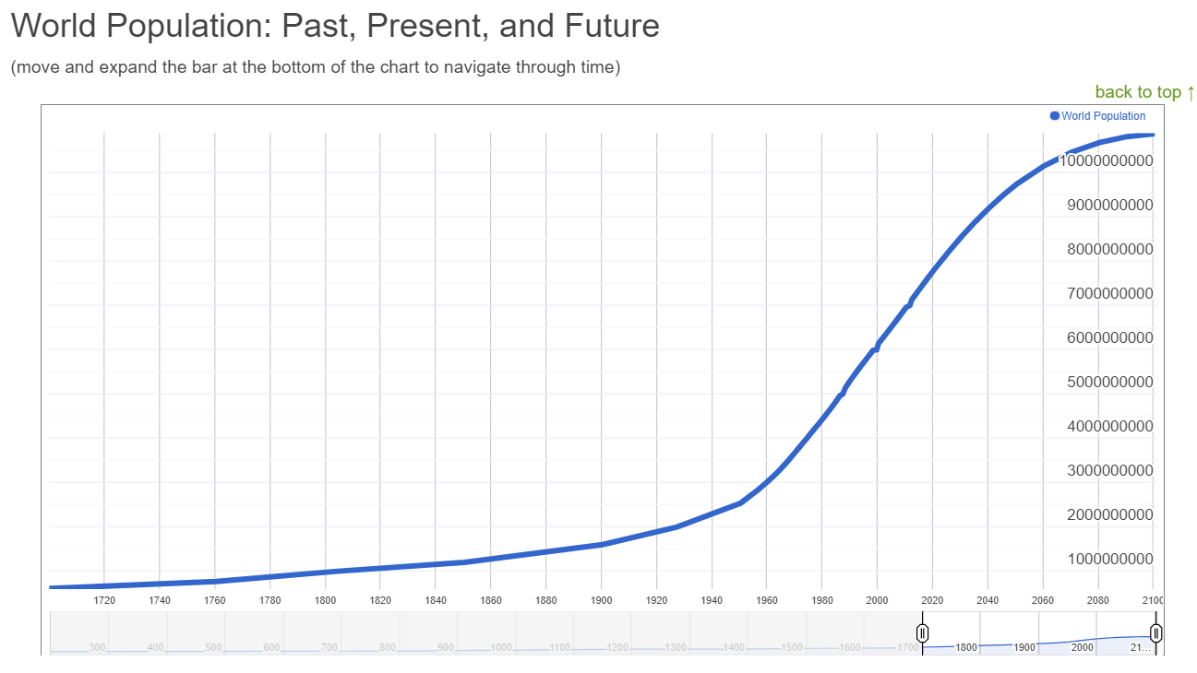
Malthus’ Law
Limit to the scale of human created content

Slide 6

AI echo chambers
Difficulties in proper segregation between training, validation and test evaluation metrics

Slide 7
Physics and symmetries
Fourier modes are the eigenfunctions for translationally invariant signals

Slide 8

Brain Prize 2024
Three theoretical physicists awarded top prize in computational neuroscience

Slide 9
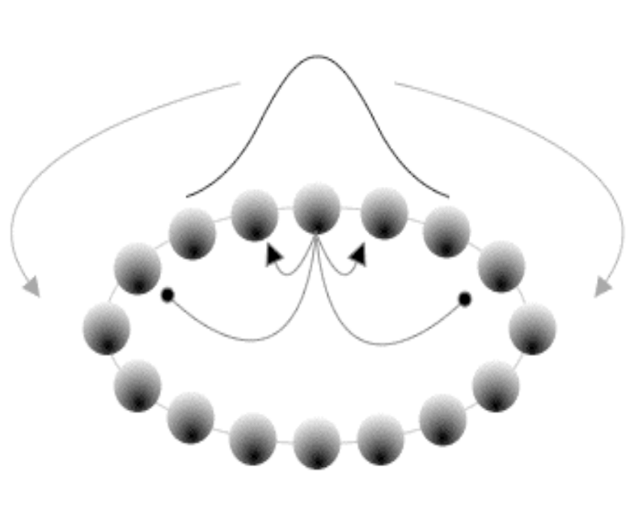
Ring attractor neural network
ReLU
Fourier modes used to construct a nonlinear recurrent neural network (Ben-Yishai, et. al., 1995)

Slide 10
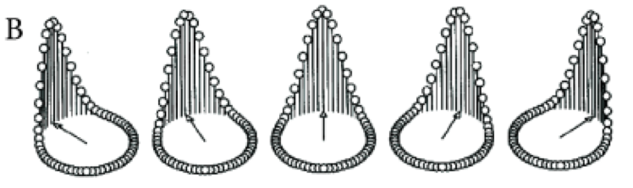
Ring attractor geometry
Neural activity space
Continuous, non-linear, low-dimensional manifold (ring) of stable states in neural activity space

Slide 11
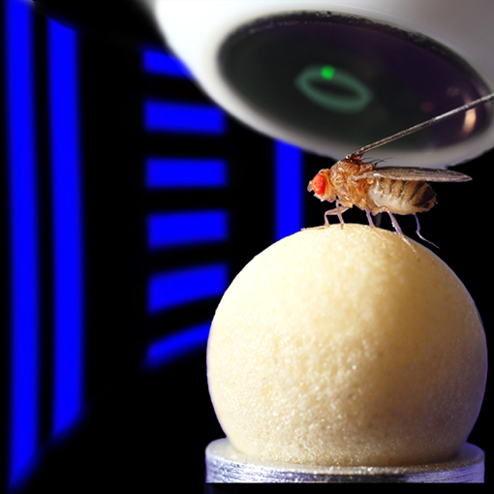
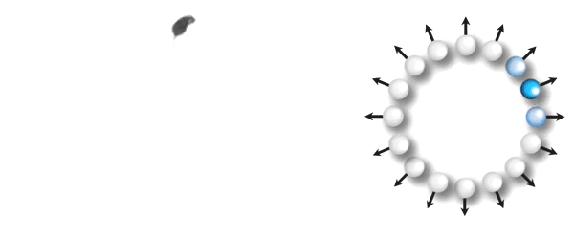
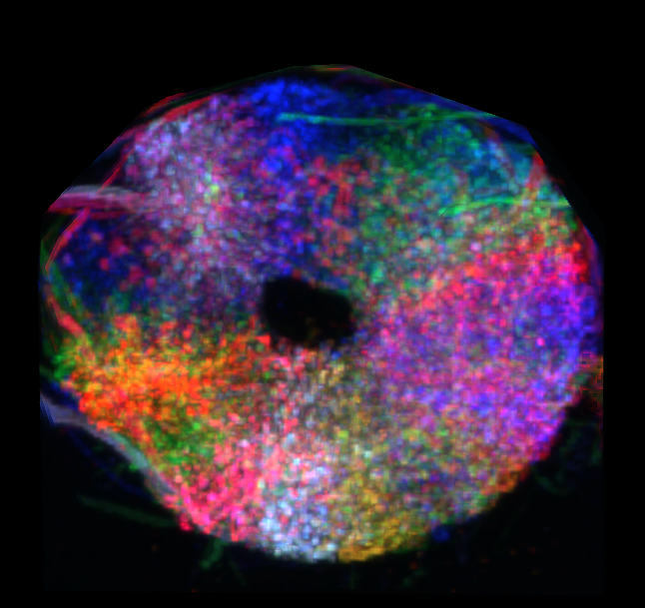
Biological head direction system
Jayaraman (2017)
Head direction (compass) neurons recorded in the ellipsoidal body of the fly brain

Slide 12
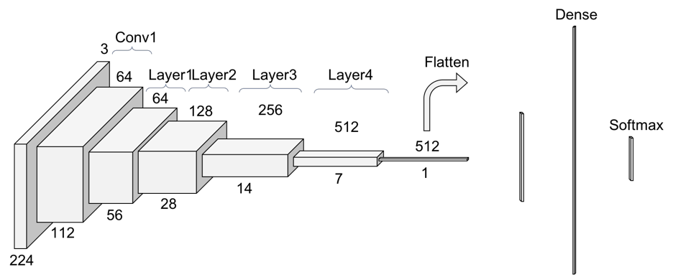
Larger and deeper networks
Success of more flexible models with increasing number of parameters

Slide 13
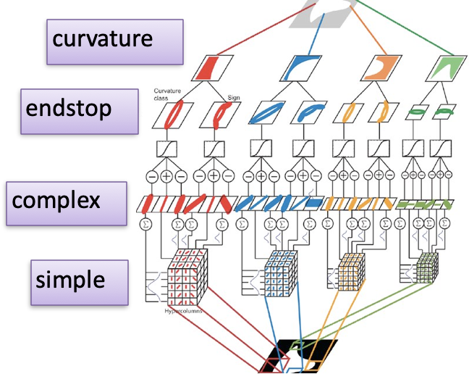
Conventional filterbank approach
Hubel and Wiesel (1963)
Failure to model deeper layers as filters with receptive fields and response kernels

Slide 14
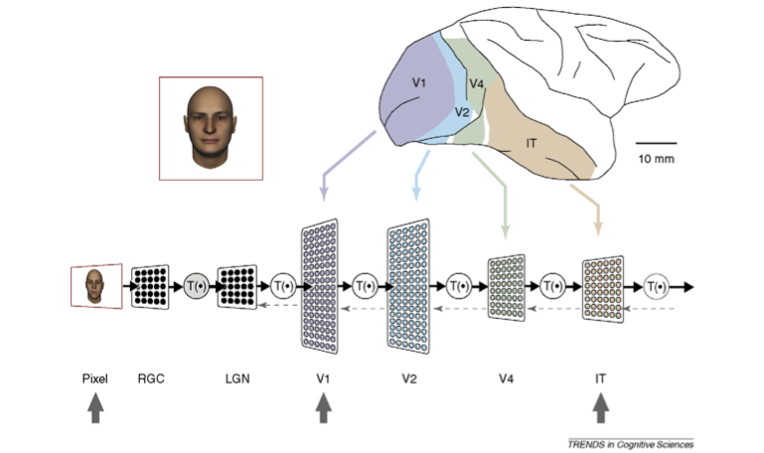
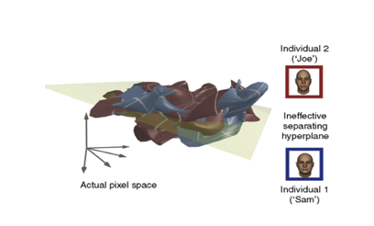
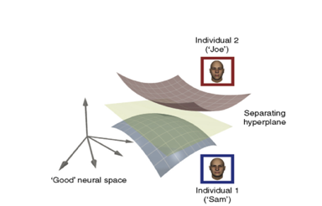
Manifold hypothesis
DiCarlo and
Cox (2007)
Neural manifold representations become “untangled” in deeper layers of processing

Slide 15



Manifold geometry and perception
“Classification and geometry of general perceptual manifolds.” Physical Review X 8.3 (2018).
“Separability and geometry of object manifolds in deep neural networks.” Nature Comm. 11.1 (2020).
Haim Sompolinsky
(Hebrew U./Harvard)
SueYeon Chung
(NYU/Flatiron)
Uri Cohen
(U. Cambridge)

Slide 16
Signal data
🐶
Vector
Representation
🐱
High-dimensional signals for multi-modal data inputs
Notes:
Perceptual manifolds arising from variability

Slide 17

Perceptron model
Frank Rosenblatt (1958)
Classic biologically-inspired model of a logic neuron

Slide 18
Perceptron geometry
Weight vector and decision surface in embedding space

Slide 19
Linear separability
Training examples:
Linear classifier:
Output layer of neural networks is a simple linear classifier

Slide 20
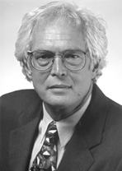
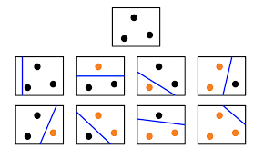
Cover counting theorem
Number of linearly separable binary labellings of P points in N dimensions:
Thomas Cover
(1965)
Dichotomies of points in general position

Slide 21
Recursion relation
P+1 point
Solve recursion relation between number of separable dichotomies with one additional point

Slide 22
Perceptron capacity
α_{c}=2
N=3
N=30
VC dim
N=300
N=3000
α=P/N
Phase transition in capacity of perceptron as N goes to infinity

Slide 23
Margin
Many possible solutions
Maximum margin
Large margin solution is robust to noise for better generalization error

Slide 24
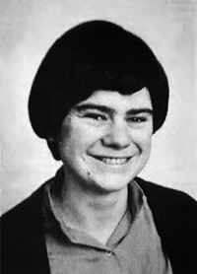
Gardner theory
Volume of hypothesis space:
Elizabeth Gardner
(1988)
Compute volume of hypothesis space

Slide 25
Replica trick
Entropy is expected log volume:
Reduction to Gaussian integrals and analytic continuation

Slide 26
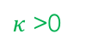
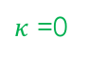
Gardner results
Capacity as a function of margin:
Separable region
$κ$ =0
$κ$ >0
Theoretical prediction for number of points at capacity, and fraction in interior or on the margin

Slide 27

Data manifolds
Lawrence Saul
Variability in pose, lighting, and expression give rise to low dimensional manifold structures
Notes:
Perceptual manifolds arising from variability

Slide 28
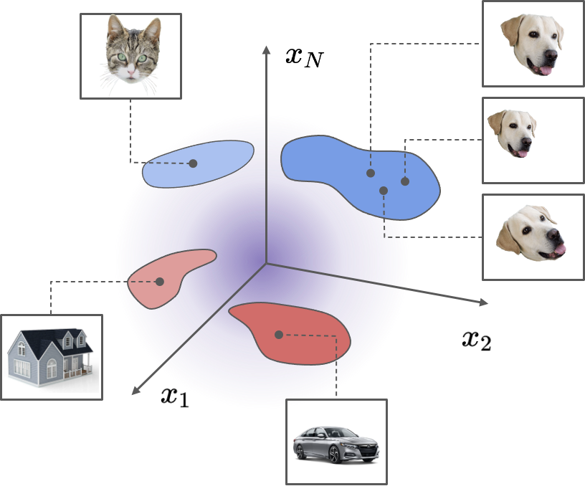
Classifying manifolds
Dichotomies of P manifolds in N dimensions:
Conventional approaches use data augmentation to increase number of training points by sampling manifolds

Slide 29
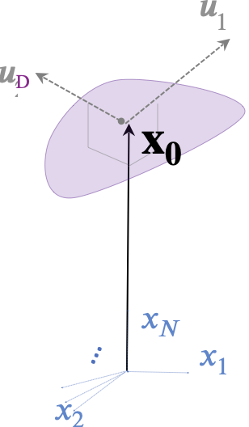
Manifold model
Geometrical description
Mathematical description of the manifold in terms of its convex hull

Slide 30
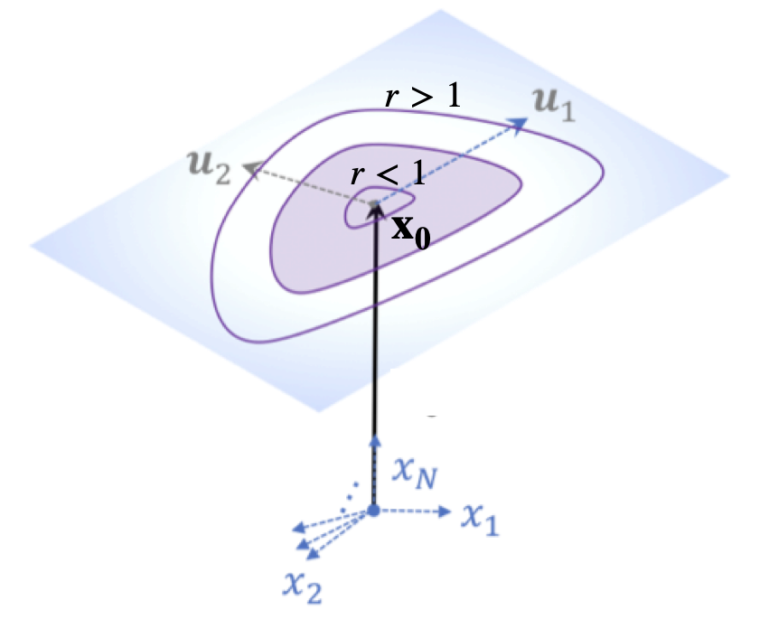
Manifold capacity limits
Small (point limit):
Large (full hyperplanes):
Random point cloud (m points):
Critical number of manifolds can vary greatly as size and shape are changed

Slide 31
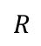
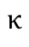
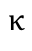

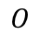
Manifold capacity formula
Critical number
of separable manifolds:
Prediction for maximum number of separable manifolds in terms of the margin

Slide 32
Effective geometry
Manifold radius:
Manifold dimension:
Classification capacity of manifolds can be described by an effective radius and dimension
Touching balls
Touching balls
Embedded balls
Interior balls

Slide 33
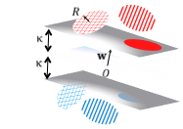
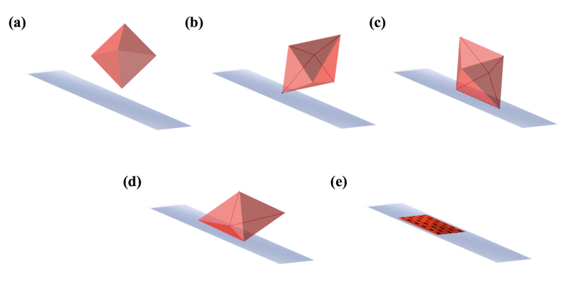
Support manifolds
Margin planes
Taxonomy of manifolds that are embedded in the margin planes

Slide 34
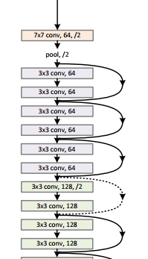
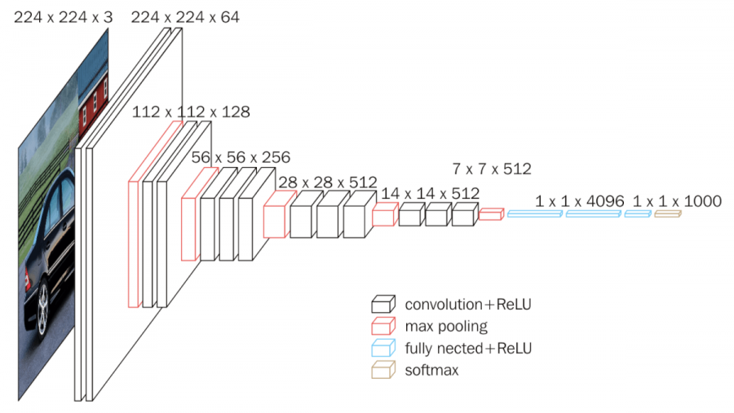
Deep network analysis
VGG-16
ResNet
Analyzing the representations in different layers of a deep networks
Notes:
Perceptual manifolds arising from variability

Slide 35
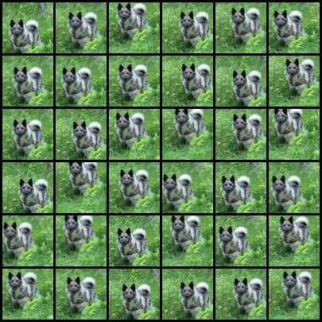
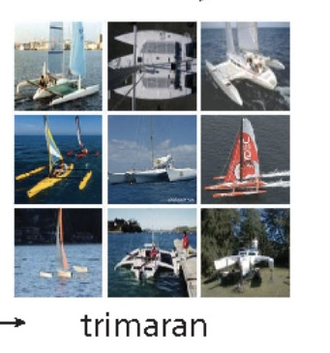
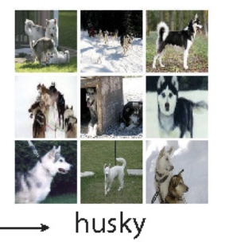
Input manifolds
ImageNet point cloud
Affine warp manifold
Analysis of two types of image manifolds: continuous affine warped manifold and point cloud convex hulls from ImageNet
Notes:
Perceptual manifolds arising from variability

Slide 36
Classification capacity
Capacity can be used to compare between layers as well as between different architectures
Notes:
Perceptual manifolds arising from variability

Slide 37
Manifold geometrical measures
Track changes to effective manifold radius and dimension through network layers
Notes:
Perceptual manifolds arising from variability

Slide 38
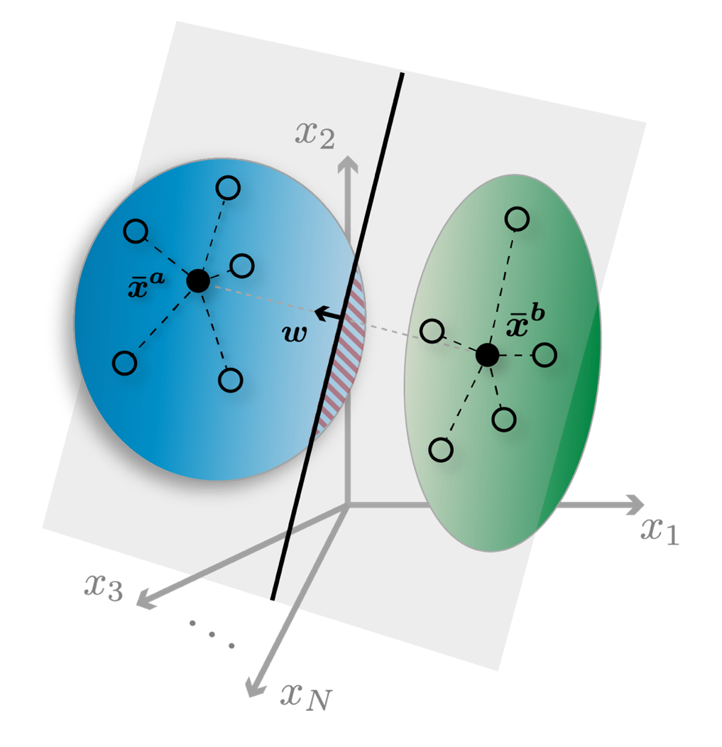
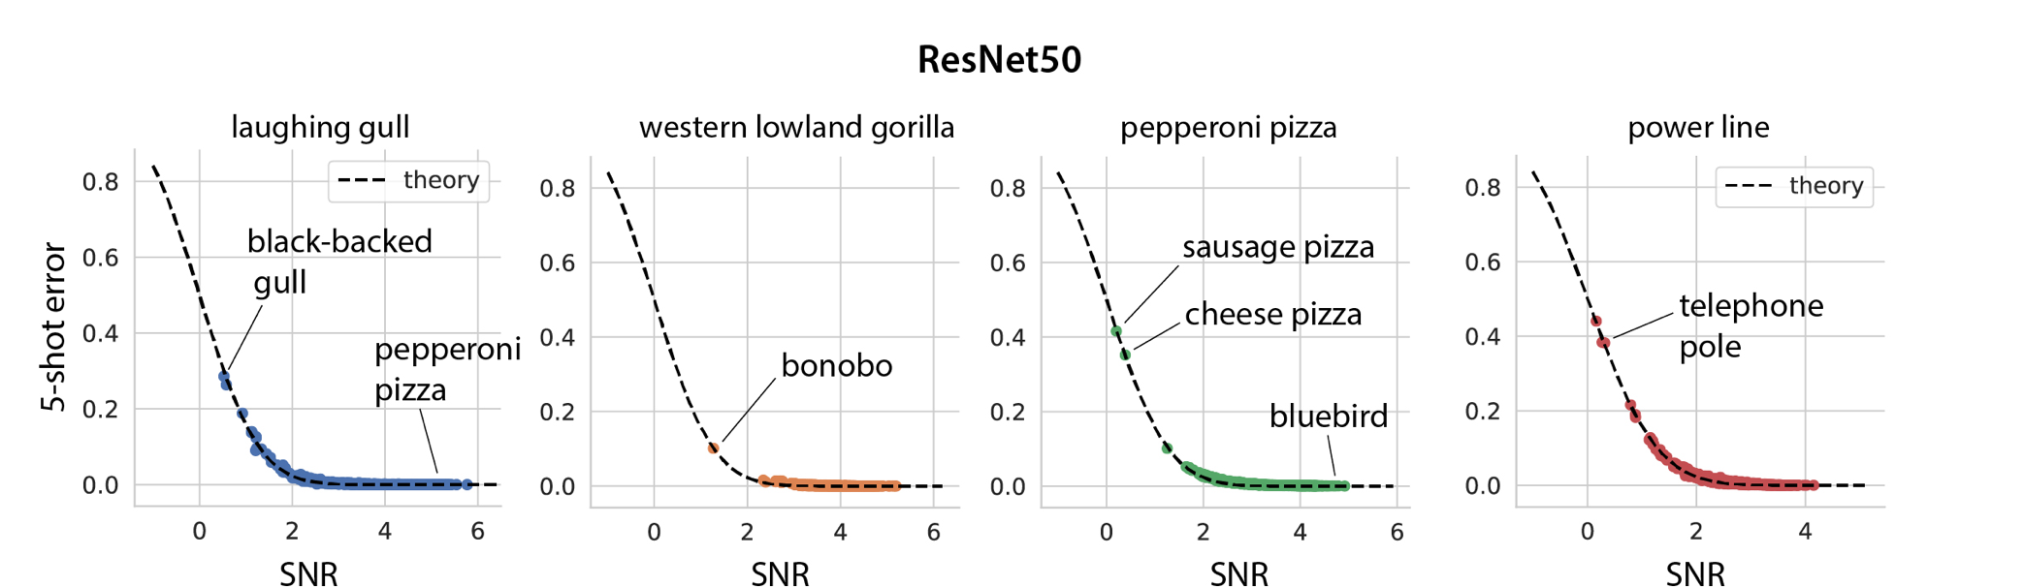
One-shot learning
Sorcher, et. al.
(2021)
Generalization error of one or few-shot learning predicted by manifold geometry
Notes:
Perceptual manifolds arising from variability

Slide 39
Neural data analysis
Chou, et. al.
(preprint)
Froudarakis, et. al.
(preprint)
Dynamical changes to the geometry of neural activity manifolds in the brain
Notes:
Perceptual manifolds arising from variability

Slide 40
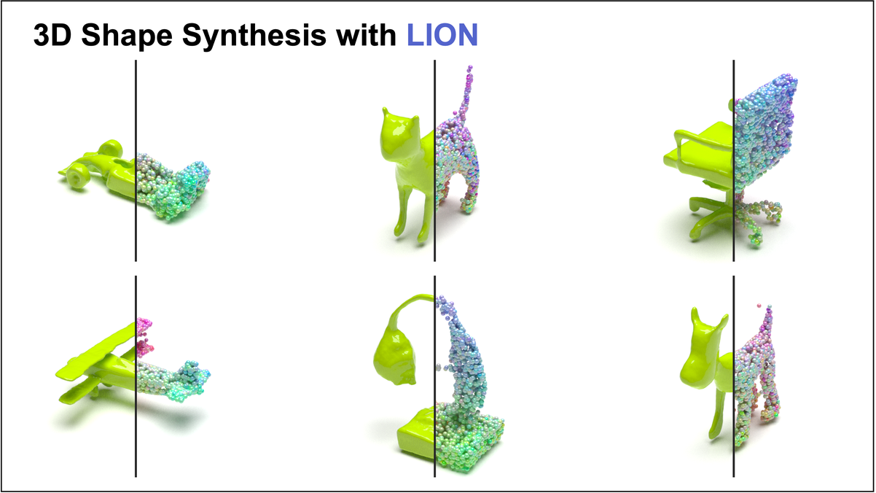

Generative diffusion models
Generating probabilistic samples from data manifolds

Slide 41
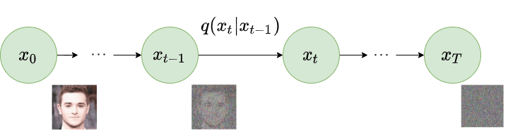
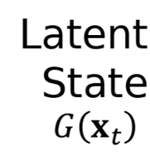
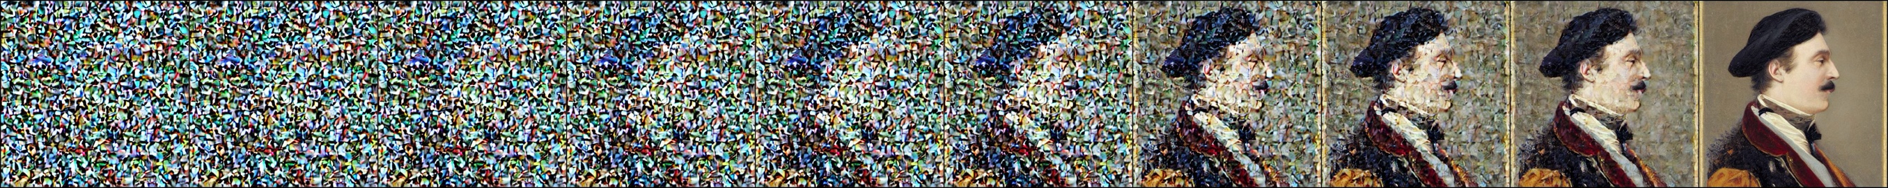
Diffusion models
Ho, et. al. (2020)
Stable-Diffusion-v1.5
Forward diffusion process iteratively adds Gaussian noise to data samples

Slide 42
Diffusion dynamics
Stochastic differential equation:
Fokker-Planck equation:
Reverse diffusion drift score function:

Slide 43
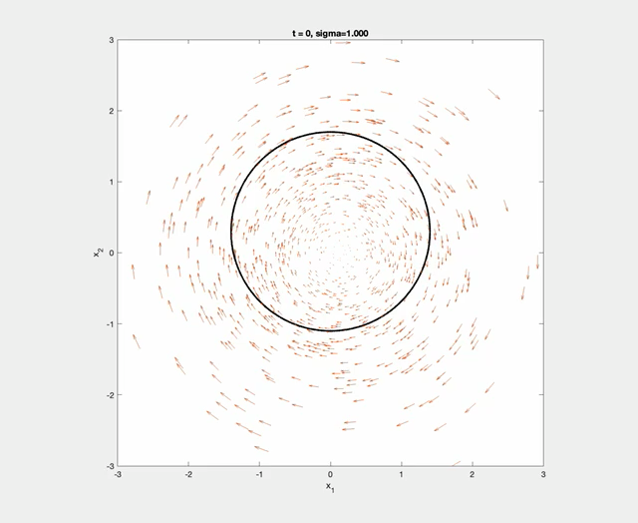
Manifold diffusion model
Chung, et. al. (2022)
Novel score function dynamics with iterative manifold projections

Slide 44
Summary
Understanding structure of data signals and representations in machine learning
Geometrical measures of manifolds for classification performance
Manifold analysis of neural brain data and machine learning networks
Incorporating geometry can lead to more efficient algorithms

Slide 45
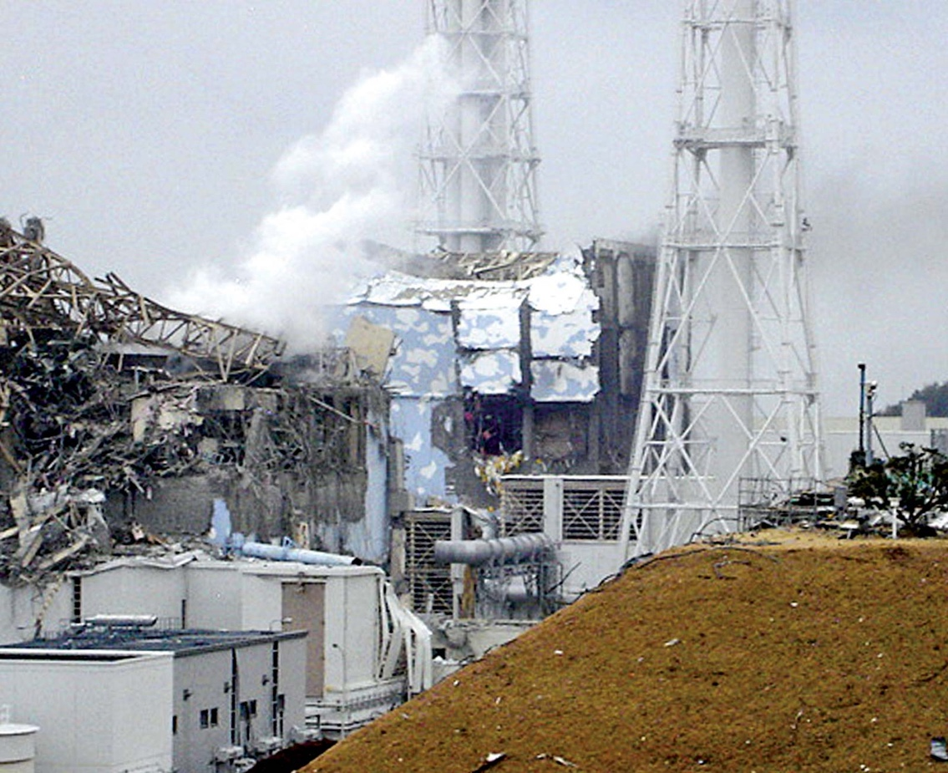
Messy embodied AI
Very large continuous state and action spaces, unknown and uncertainty in dynamics, nonstationary environments
Notes:
Motivation

Slide 46

Still much to learn

